Slide 1

The Effects of Mixed Institutional Messaging During the COVID-19 Crisis
William G. Resh
Associate Professor
May 6, 2020
“Policy in a Pandemic” Series

Slide 2
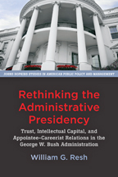
An Introduction
General Research Focus: In what ways do political environments and executive interventions affect policy implementation and citizen behavior?
    Rethinking the Administrative Presidency (Johns Hopkins University Press)
      2019 Herbert A. Simon Award (American Political Science Association)
      2017 Best Book Award (American Society of Public Administration)

Slide 3
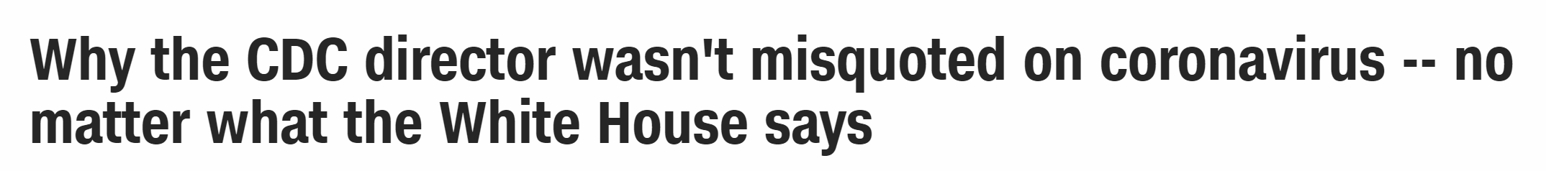
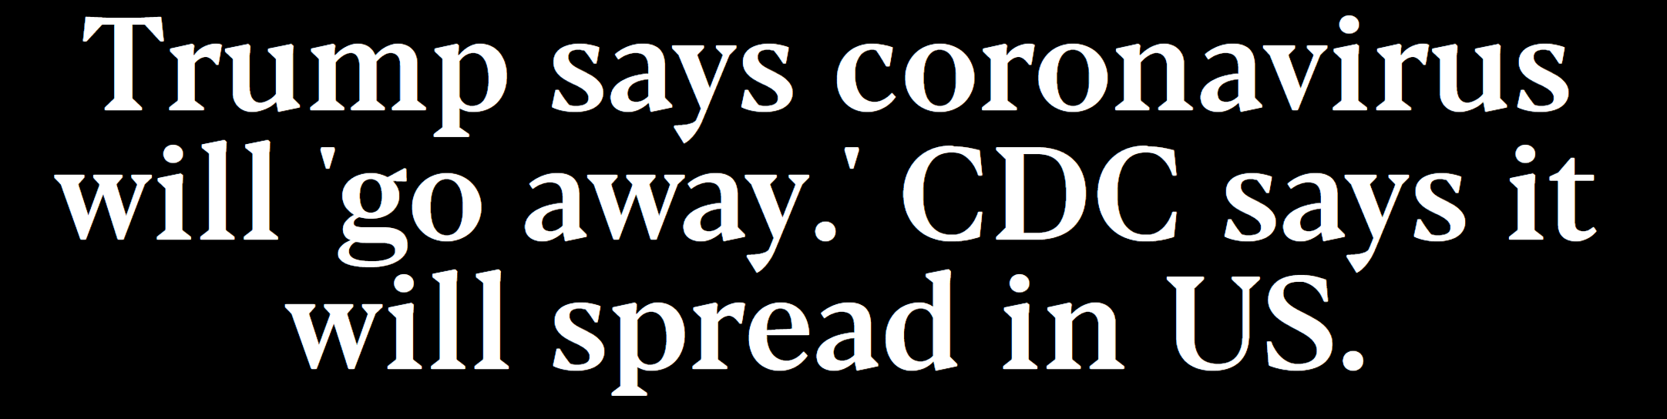
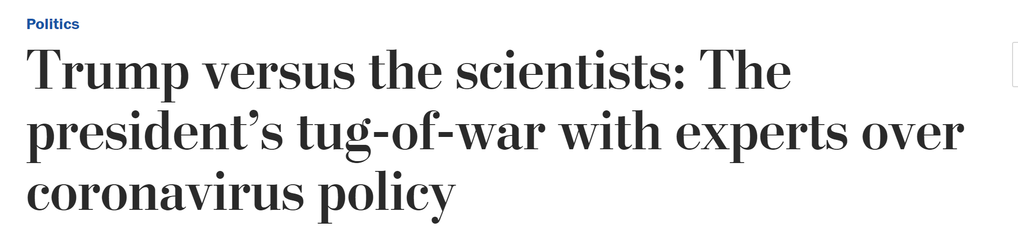
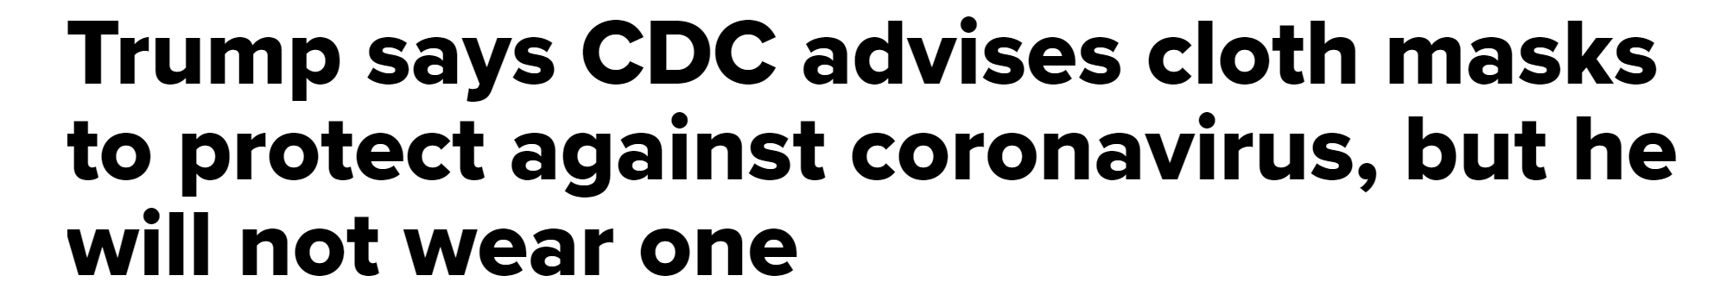
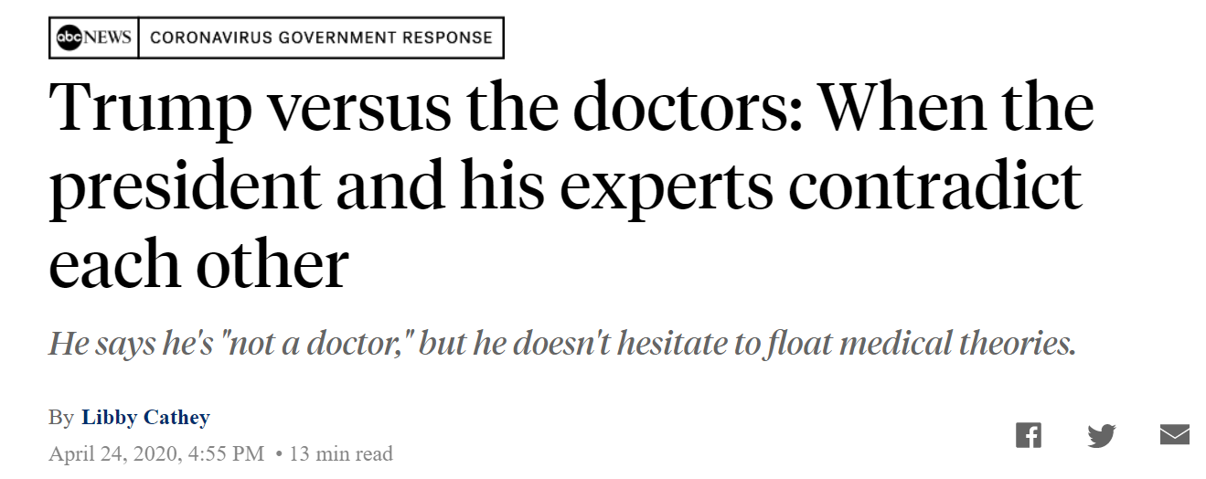
Notes:
To this end, I’m quite interested in the effects of the mis-alignment between this president and the civil service institutions that are primarily responsible for providing public health awareness and insights to protecting the public during this crisis. We find persistent disagreement between what the president says and what CDC, for instance, says about the best direction for policy during this crisis.

Slide 4
An Introduction
Today’s talk: Mixed Institutional Messaging
Setting: COVID-19 Crisis in the United States
Objective 1: To test the effect of the president’s persistent conflict with expert opinion on topics of uncertainty during the COVID-19 crisis
  How do citizens update their priors as a function of exposure to the president’s position on a given topic?
  What about when that exposure is countered by added exposure to the CDC’s position on the same topic?

Slide 5
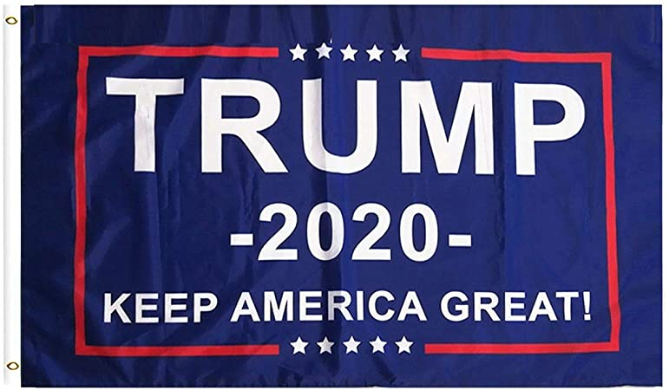
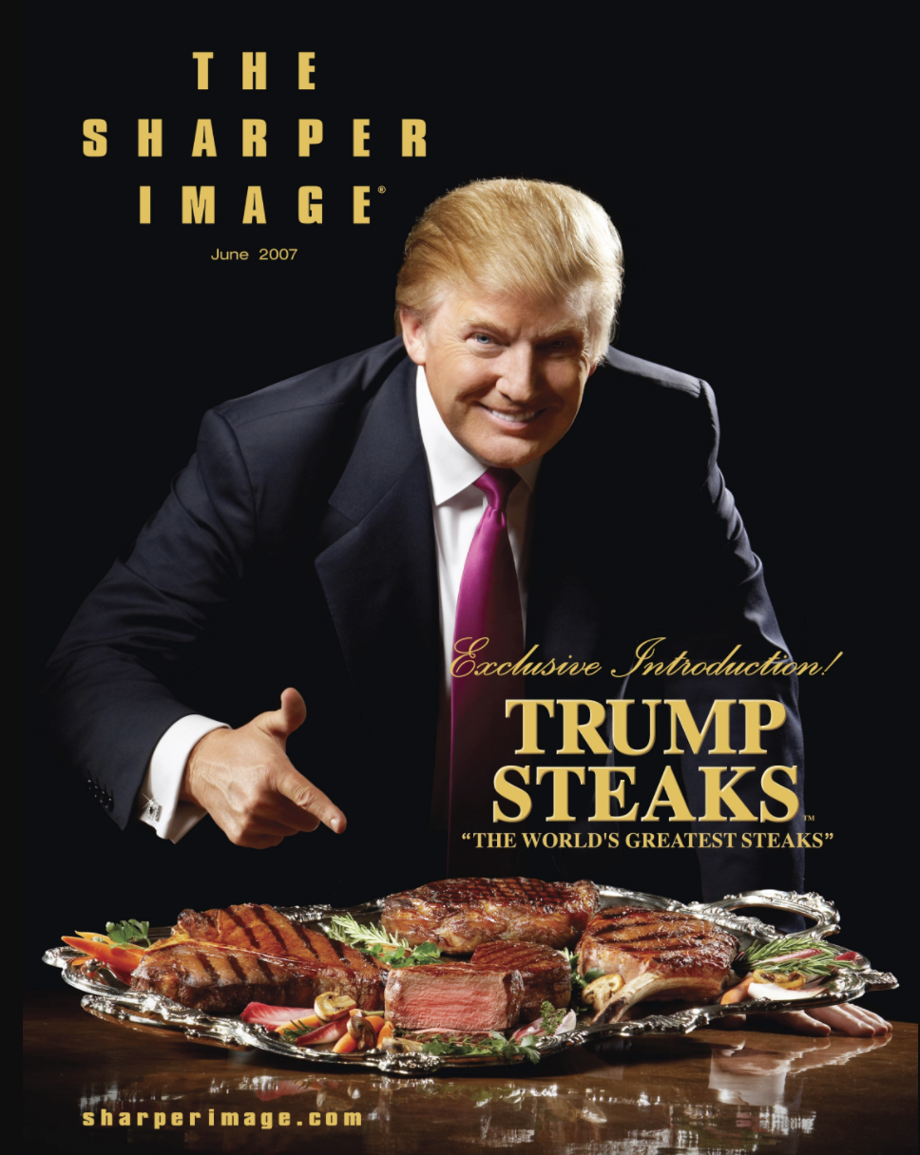
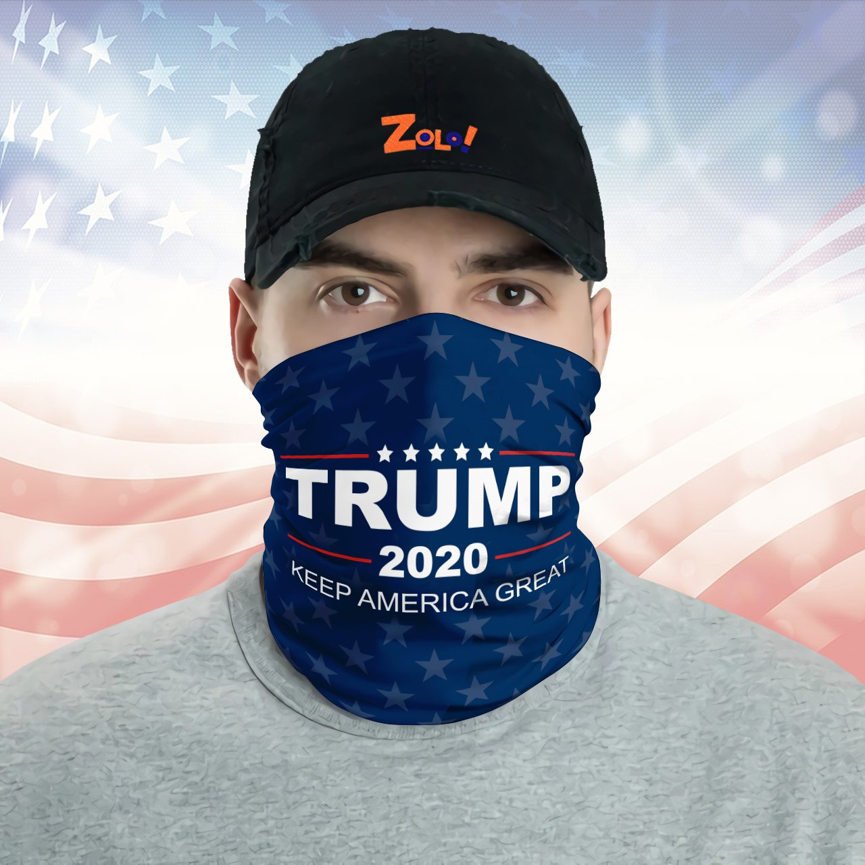
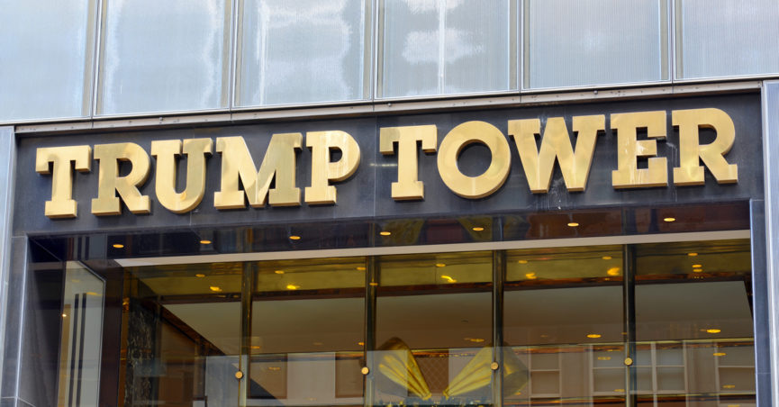
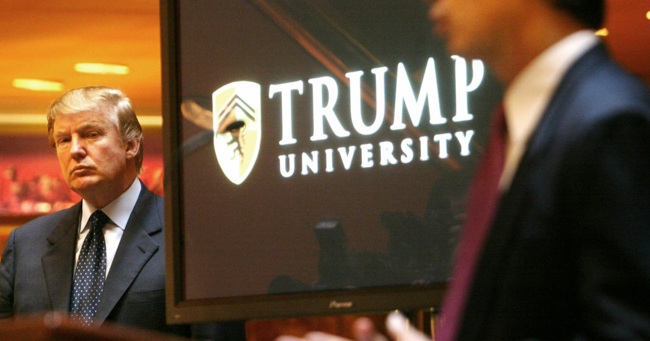
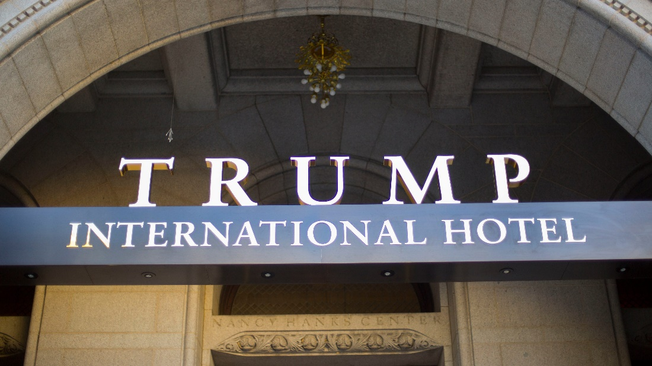
Notes:
As well, we will examine the concept of branding during this crisis. Specifically, we will examine how the Trump administration’s attempts at including Trump’s name in various communications to the public are effective in promoting his reelection hopes. We’ve never seen a president such as Trump, someone who’s commercial brand has been so intrinsically linked to his political brand or one that’s been as prominent in his life as a private citizen before becoming president.

Slide 6
An Introduction
Today’s talk: Mixed Institutional Messaging
Setting: COVID-19 Crisis in the United States
Objective 2: To test President Trump’s implicit brand equity during the crisis
  The “Trump” brand has a long legacy in both the private sector and in politics.
  We test the extent to which the Trump administration’s use of Trump’s name in public service announcements is associated with how citizens approve of his job during the crisis

Slide 7

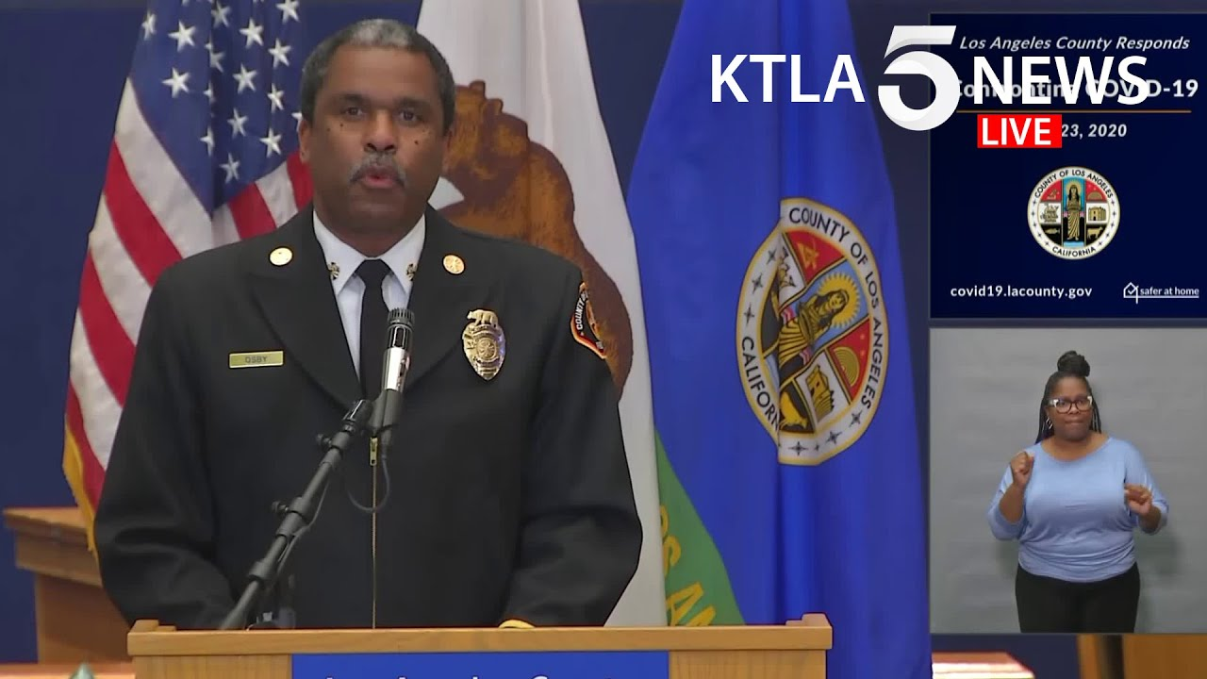
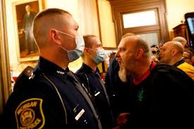
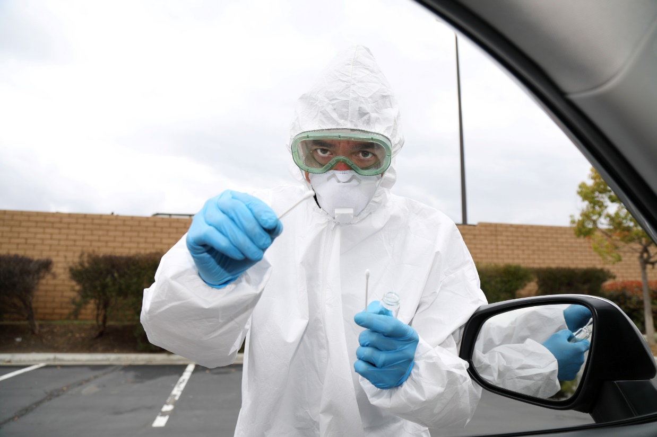


Notes:
Finally, we will touch on very recent research that is still in process, which examines the day-to-day stresses of those public servants on the front-lines of this crisis. Namely, we follow over 200 local government workers over a period of three weeks in April and May who are responsible for delivering public services, providing first response and public health awareness, and enforcing stay-at-home and social distancing provisions.

Slide 8
An Introduction
Today’s talk: Mixed Institutional Messaging
Setting: COVID-19 Crisis in Los Angeles County
Objective 3: To understand how mixed institutional messaging during the crisis at the national and state level can affect front-line workers at the local level
  In a “diary method approach,” we followed over 200 local government employees who filled out daily journals for three weeks (April 13-April 30, 2020) in the midst of the crisis.
  Provides real-time insights on the stresses that mixed institutional messaging can cause as well as the emotional labor public servants employ when engaging with the public.

Slide 9
Mixed Institutional Messages and Bayesian Updating under Uncertainty: A COVID-19 Case Study
William Resh
Tima Moldogaziev
Penn State University
&
John D. Marvel
George Mason University

Slide 10
To What Extent Do Voters Trust the Federal Government on Topics of Uncertainty in Crisis?
Trust requires an assessment of the “trustee’s” integrity, competence, and beneficence.
But, perhaps most importantly, it requires an assessment of the extent to which the “truster” (voters) perceive that their interests are encapsulated in the actions of the trustee (the government) (Hardin, 2002).
Hence, in a highly polarized political environment, it is likely that “encapsulated interest” is correlated with partisan identification.
Notes:
“Trust is the foundation of any successful relationship — including the relationship between the government and the governed. And during a pandemic like this one, it’s no abstract matter.”

Slide 11
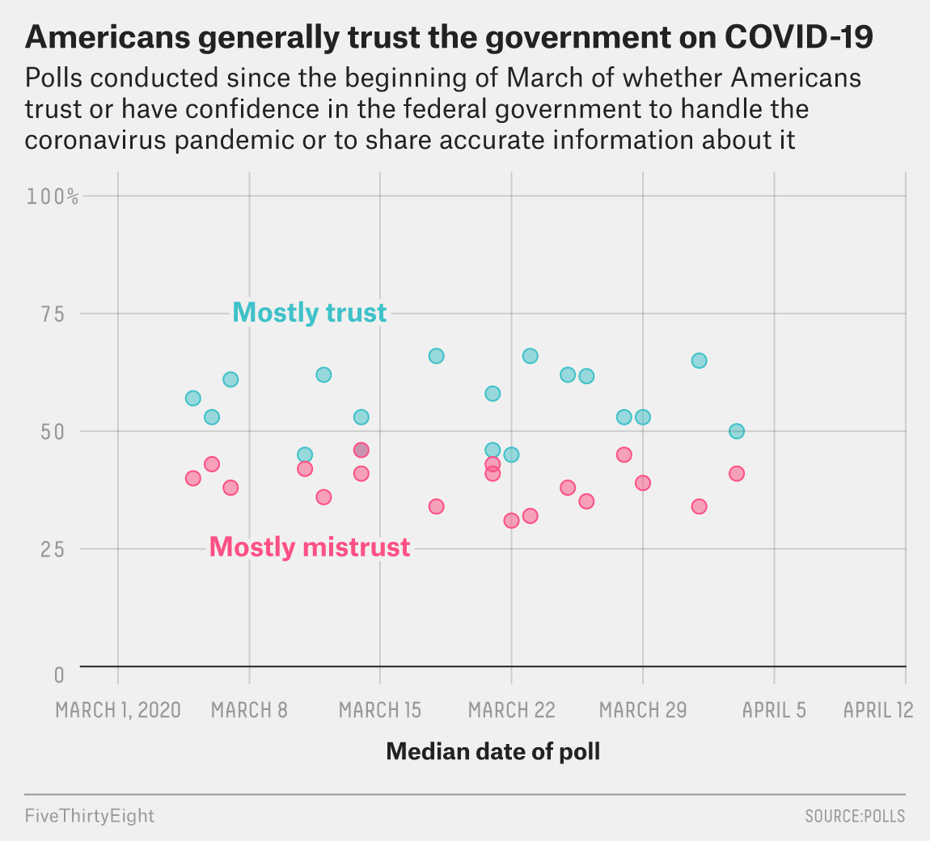

Slide 12
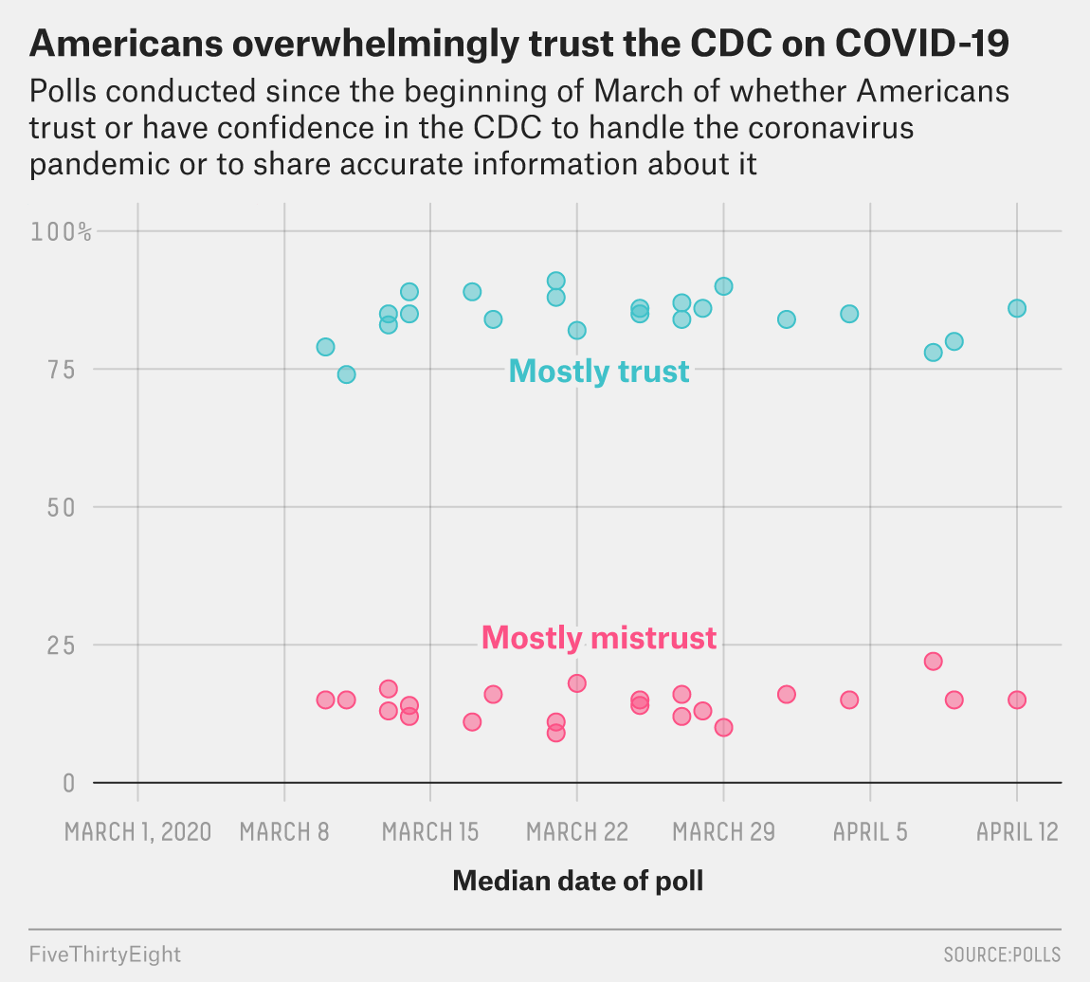

Slide 13
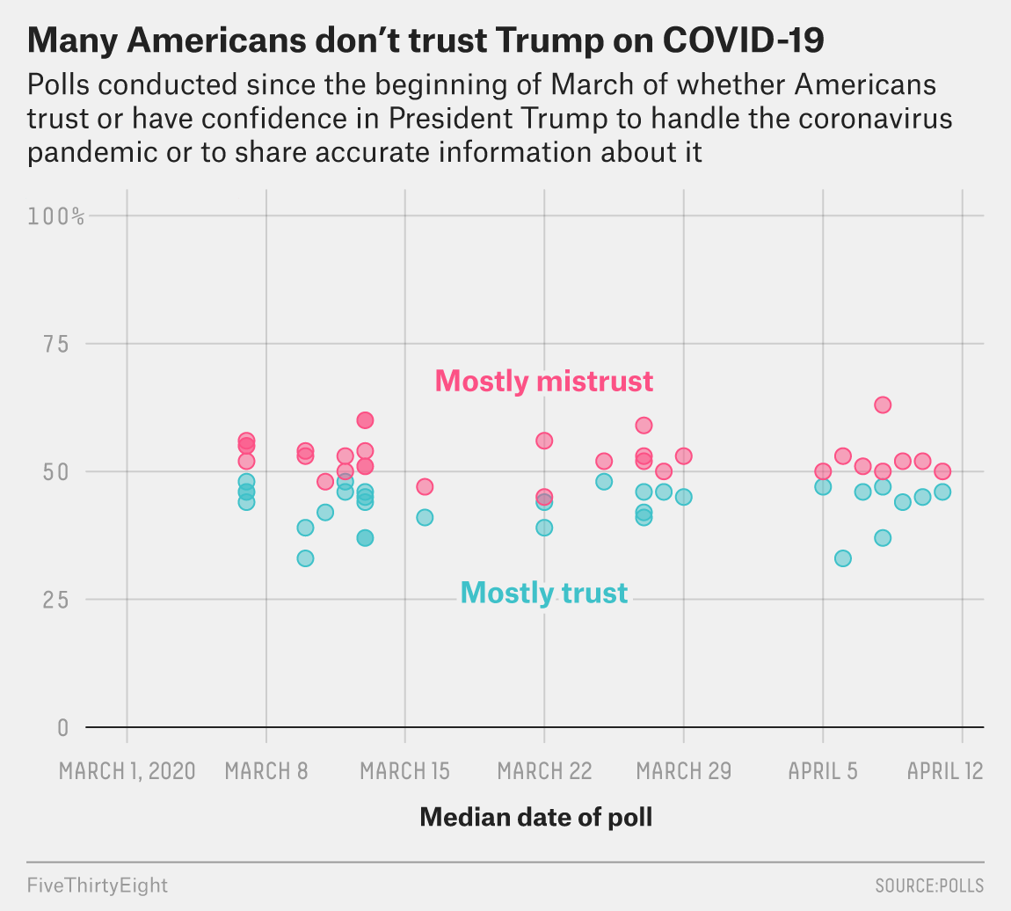

Slide 14
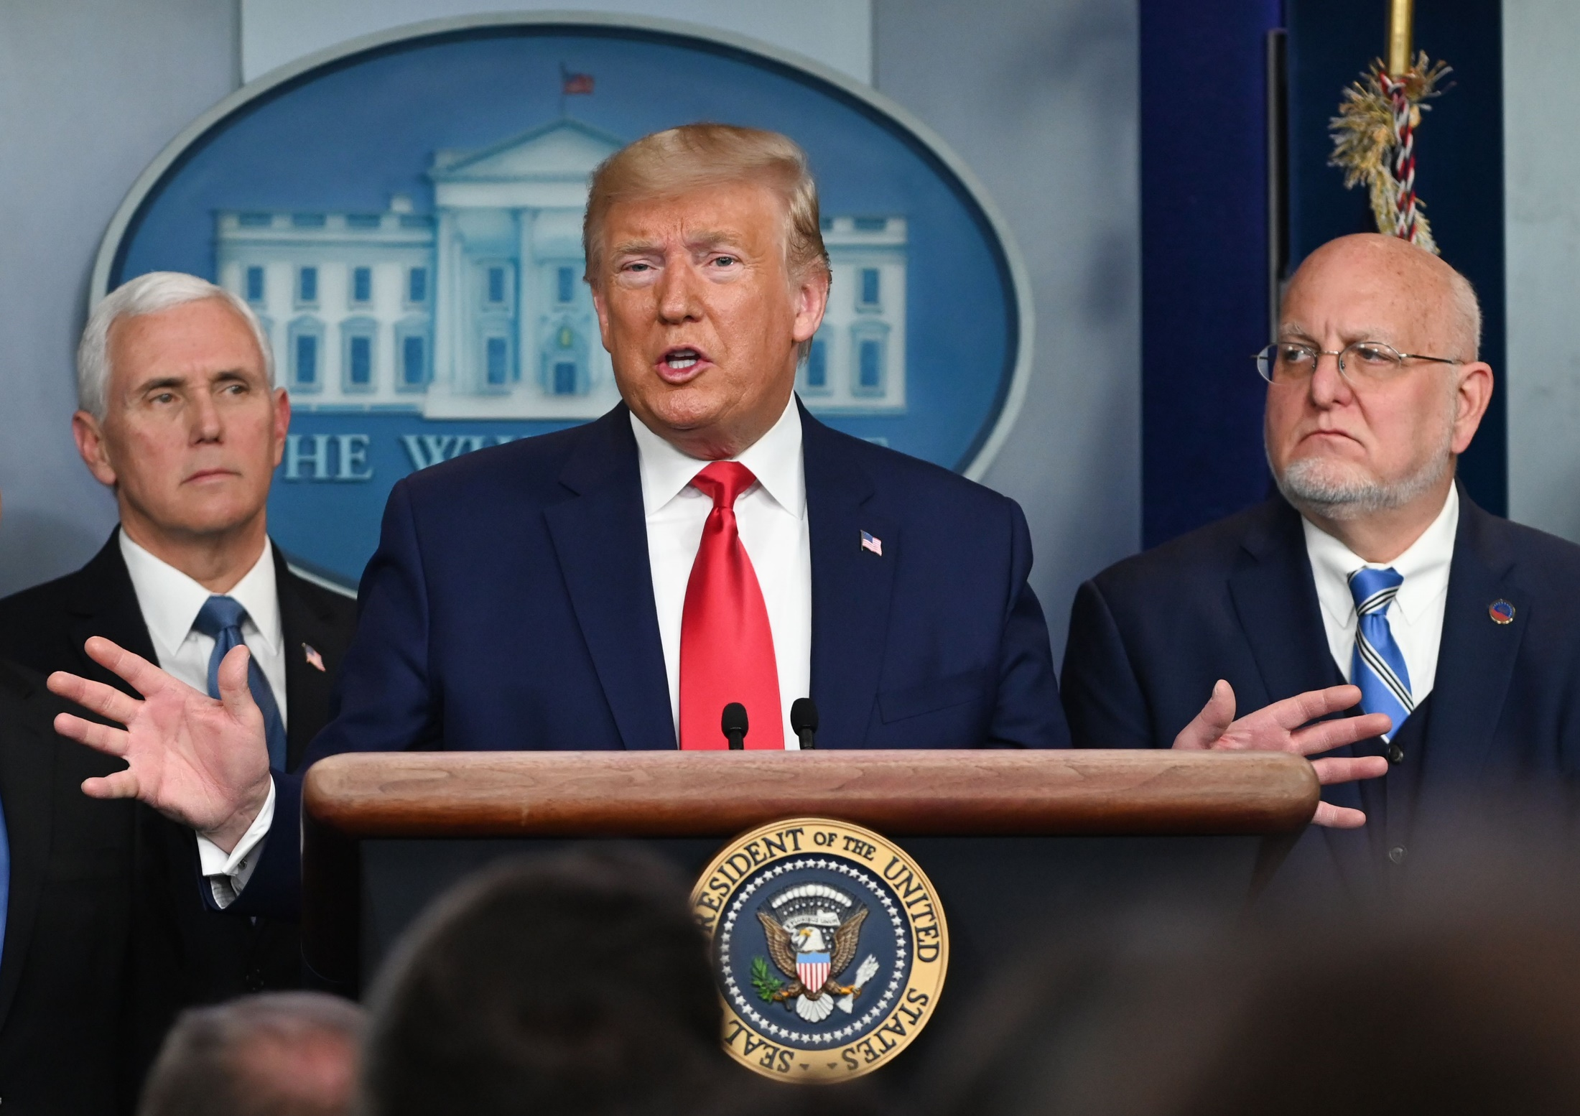

Slide 15
CDC Director, Robert Redfield

Slide 16
Survey Experiment:
Updating Priors about COVID-19
SO, what happens when the president and the CDC openly disagree on important topics related to the crisis?
In a survey, we asked >1,000 US voters to make their best estimate on three points of uncertainty regarding the COVID-19 crisis:
  What is the case fatality rate of COVID-19?
  How long do you think it will be until a vaccine is developed?
  How important is it to wear a mask in public to prevent the spread?

Slide 17
Survey Experiment:
Updating Priors about COVID-19
Each subject (i.e., voter) was first given very basic information about each of these uncertainties, so that we could make sure that they had at least some informed opinion.
Then, they were asked to give their best guess.

Slide 18
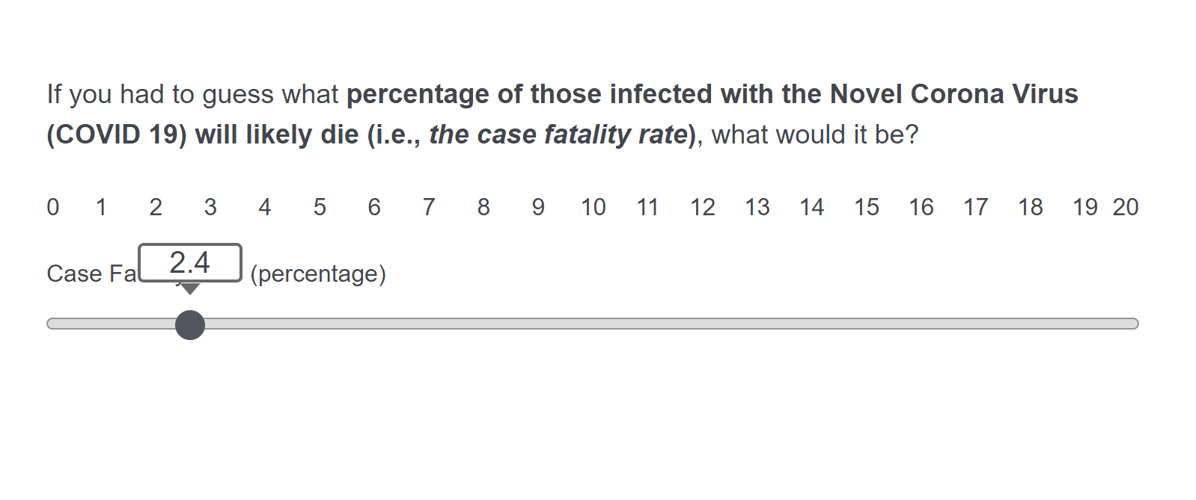

Slide 19
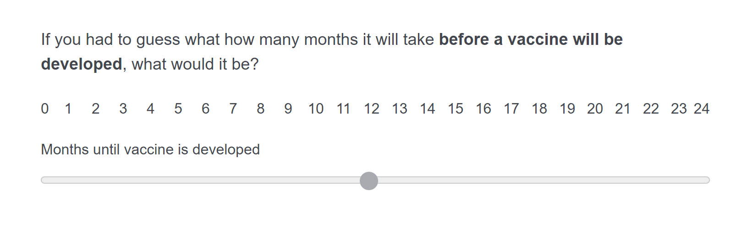

Slide 20
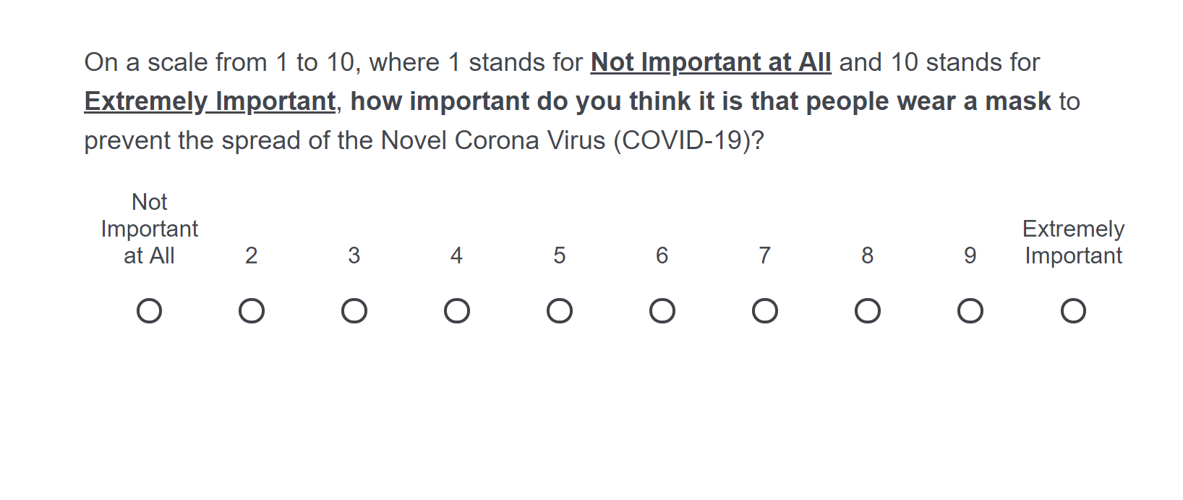

Slide 21
Survey Experiment:
Updating Priors about COVID-19
Each subject (i.e., voter) was then randomly assigned to one of two groups:
  The control group, which was exposed to only Trump’s stated position on the three topics.
  The “treatment” group, which was exposed to both Trump’s position and the stated position of the CDC.

Slide 22
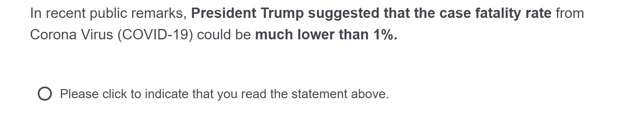
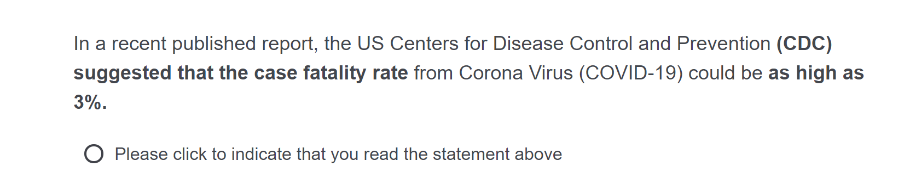
Survey Experiment:
Updating Priors about COVID-19
Trump’s position on CFR:
CDC’s position on CFR:

Slide 23
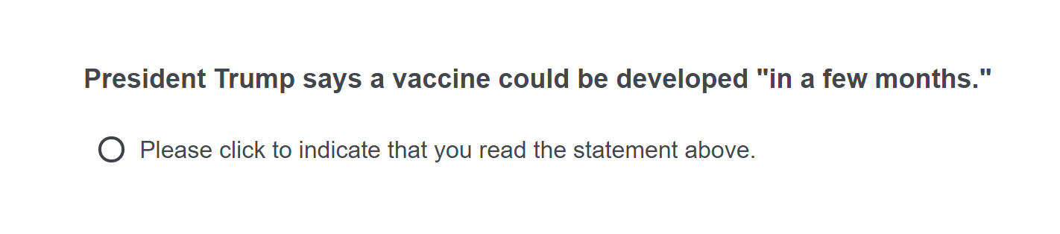
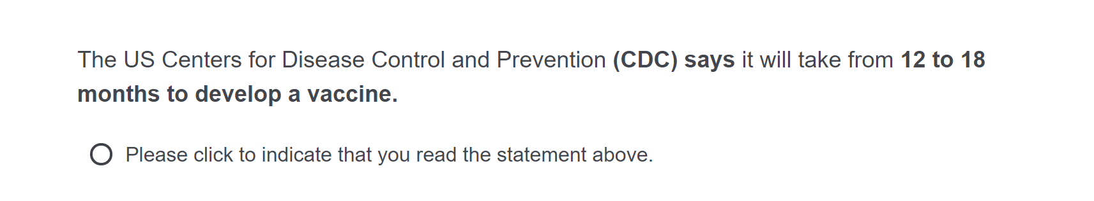
Survey Experiment:
Updating Priors about COVID-19
Trump’s position on when a vaccine may be ready:
CDC’s position on when a vaccine may be ready:

Slide 24
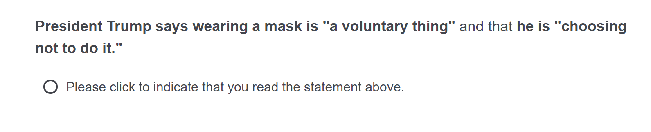
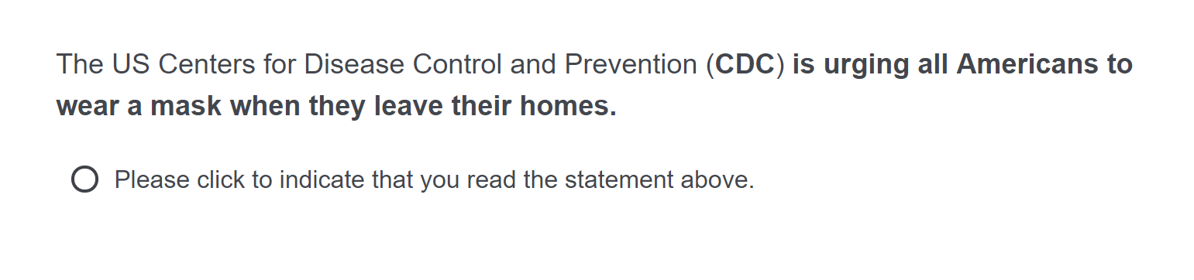
Survey Experiment:
Updating Priors about COVID-19
Trump’s position on the importance of masks:
CDC’s position on the importance of masks:

Slide 25
Survey Experiment:
Updating Priors about COVID-19
Subjects were then offered the same scales a second time and asked if they would like to update their previous estimates
We are then able to capture the extent to which exposure to different information sources leads to updates in a direction that better align with a given source.

Slide 26
Confidence Interval

Slide 30
Take-Aways from Mixed Messaging Experiment
Inconsistency in institutional messaging matters!
People update their priors according to the information to which they are exposed.
But not all information sources are equal.
On average, voters seem to update their priors on points of uncertainty about the crisis more towards CDC than the president
  NOTE: *when they are exposed to the CDC’s position*

Slide 31
The ‘Trump Card’ and Branding Effects of a National PSA during the COVID-19 Crisis
William Resh
Tima Moldogaziev
Penn State University
&
John D. Marvel
George Mason University

Slide 32
Brand Equity and the Effects on Trump’s Reelection Campaign
We test the associations people have with the Trump administration’s latest “branding” effort.
We provided over 1,000 US adults a picture of the public service announcement (PSA) that was sent to every American household back in early March, outlining the guidelines recommended by the CDC to “Slow the Spread.”
Remember this one?

Slide 33
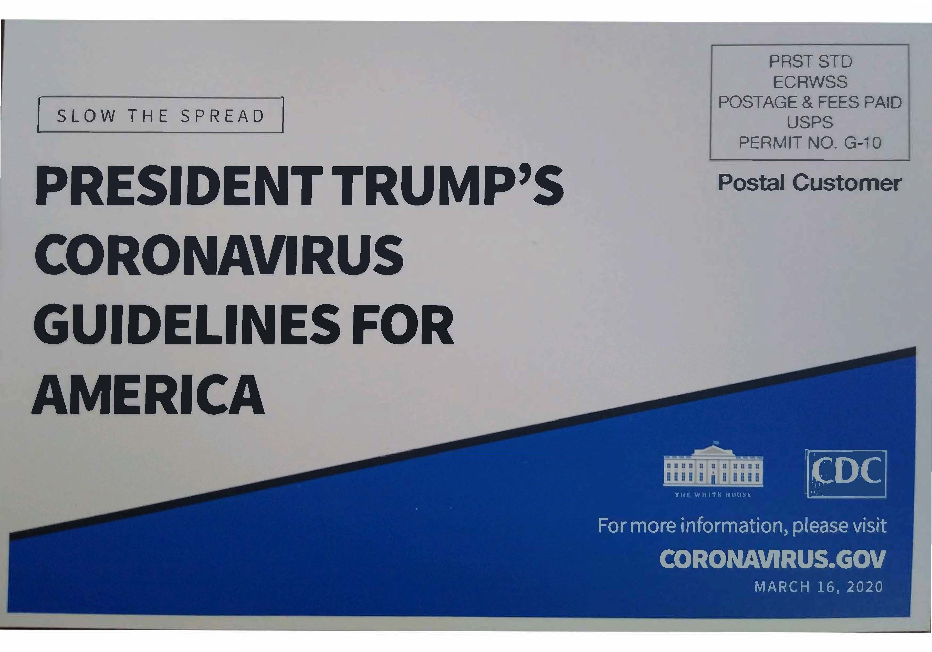

Slide 34
Survey Experiment:
Updating Priors about COVID-19
We then asked respondents to click on the first thing that they notice on the card.
In doing so, we capture the implicit association people make with the purpose of the card.
We then ask a series of questions related to the crisis. In particular, we ask subjects their relative approval of Trump’s general job performance as well as his performance handling the crisis.
In correlating their implicit associations with Trump’s name to their assessments of his job, we can measure Trump’s “brand equity”
  Brand Equity: the value that derives from consumer perception of a brand name

Slide 35
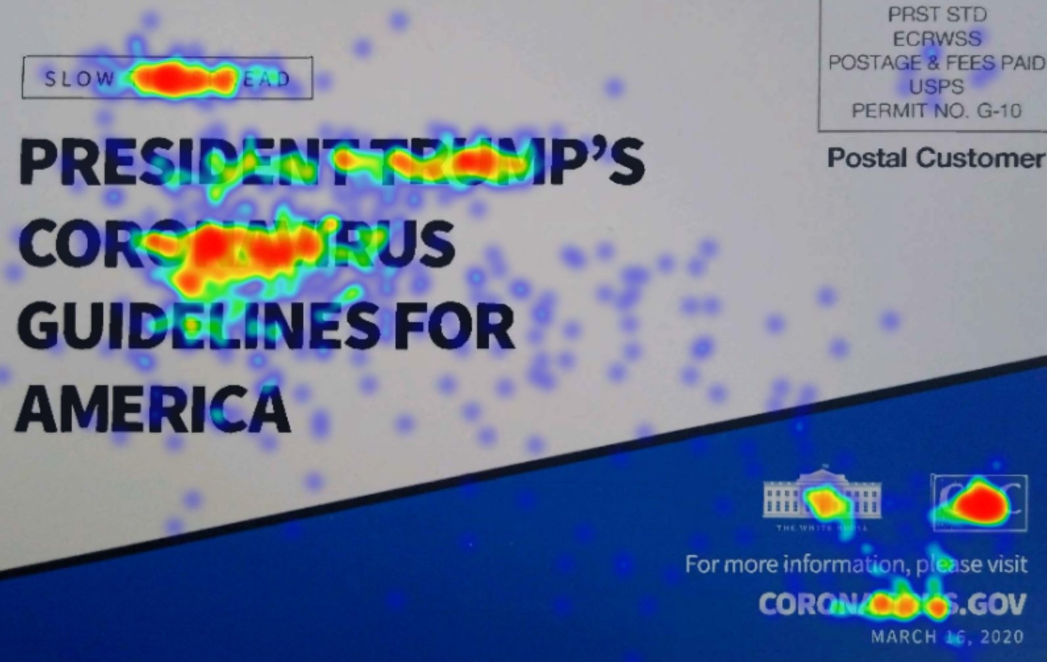

Slide 36
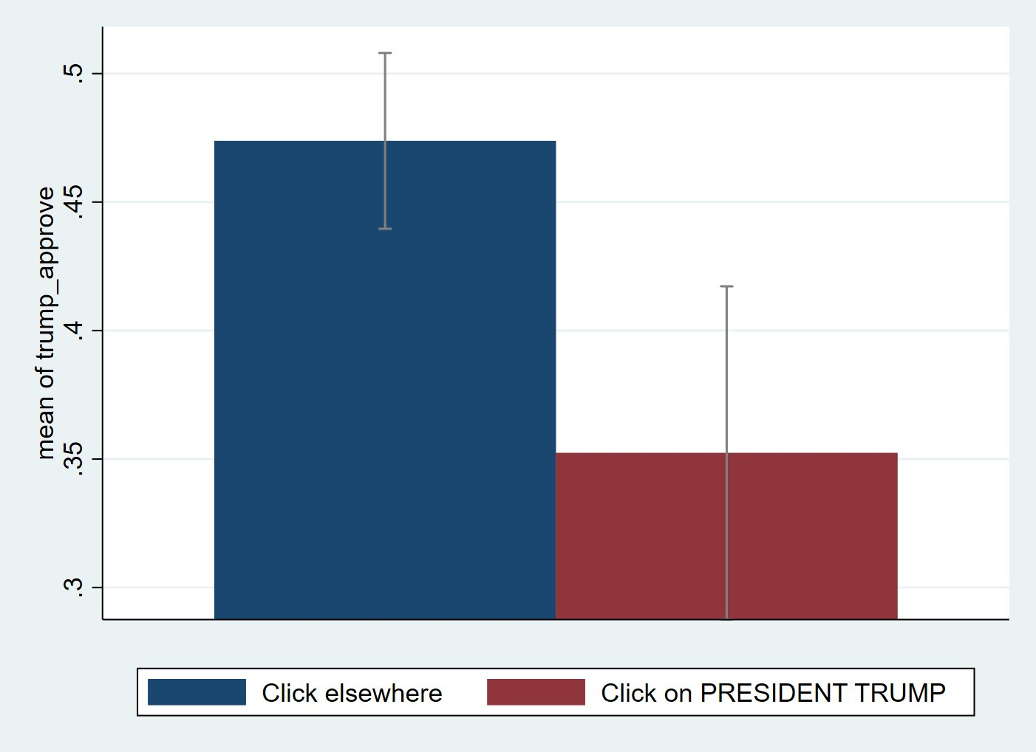

Slide 37
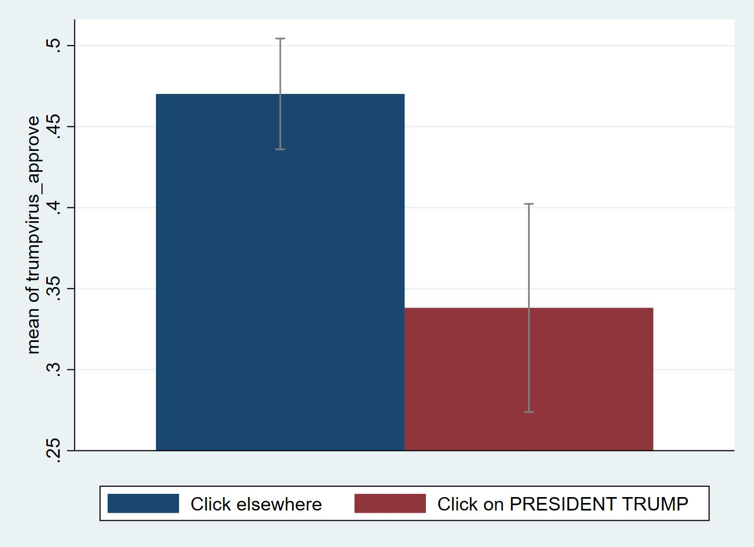

Slide 38
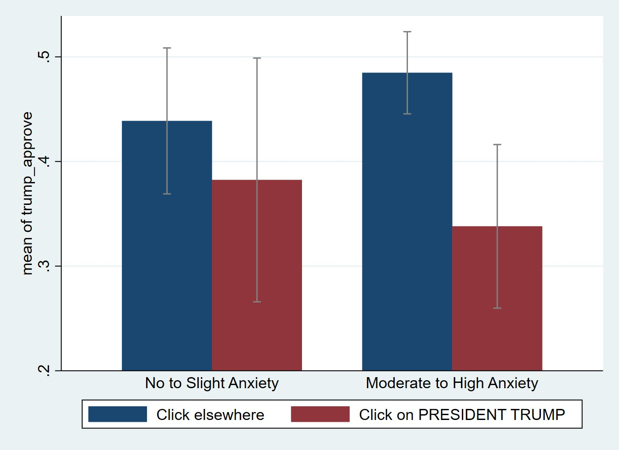

Slide 40
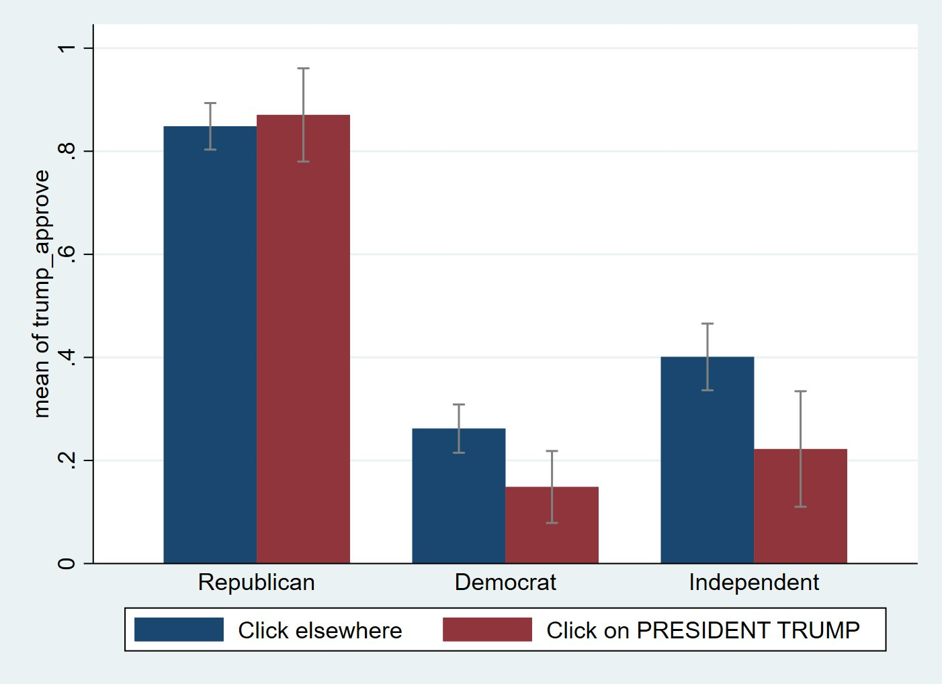

Slide 44
Take-Aways from Trump Branding Experiment
In the eyes of both Democrats and Independents, any implicit association of the PSA card to President Trump leads to more negative assessments of his job generally and in addressing the crisis
In other words, Trump’s name appears to carry negative brand equity
Implicit association of Trump’s name to the PSA effort and perhaps otherwise (stimulus checks?) may lead to deleterious effects for his reelection campaign

Slide 45
A Diary Method Approach to Understanding the Emotional Toll of the COVID-19 Crisis on the Front-Lines
William Resh
&
Cynthia Barboza-Wilkes

Slide 46
Data and Measures
In a “diary method approach,” we followed over 200 local government employees who filled out daily journal surveys for three weeks (April 13-April 30, 2020) in the midst of the crisis.
Among many other topics, we asked these local public servants the extent to which any of the following political actors hindered or helped them in jobs that day.
  A score of 7 would indicate a “great amount of help,” whereas a score of 1 would indicate a “greatly hindered.”

Slide 48
Data and Measures
We followed these questions with diary entries that allowed us to collect a great deal of qualitative evidence on the daily obstacles and stresses that these public servants face on the front-lines of the crisis.
The data collection continues with exit interviews over the next two weeks.

Slide 49
Data and Measures
However, we can say that over 40% of respondents indicated that mixed messages on the national, state, and local levels complicate their jobs.
Moreover, we asked how the political environment in which they operate causes them stress.
Here were some of their answers:

Slide 50
The Political Environment:
Examples from the Front Lines
Citizens approach them with confusion over messages they receive from the news, particularly news from Trump’s daily briefings.

Slide 51
The Political Environment:
Examples from the Front Lines
An impression that City Council members sometimes use the crisis as an opportunity to push tangential agendas, thereby wasting departmental resources in addressing those agendas.

Slide 52
The Political Environment:
Examples from the Front Lines
Uncertainty over furloughs, cutbacks, and other economic uncertainties (including for their spouses/partners/family) induce stress and anxiety

Slide 53
The Political Environment:
Examples from the Front Lines
Lack of clarity on priorities during the crisis induces frustration and anger

Slide 54
The Political Environment:
Examples from the Front Lines
Conflicting information leads to noncompliance of health directives regarding distancing and masks.

Slide 55
The Political Environment:
Examples from the Front Lines
City and national politics is determining resource outlays and not community need.

Slide 56
The Political Environment:
Examples from the Front Lines
New information from federal sources less reliable or timely than the actions taken by State and County governments.

Slide 57
Conclusion
Mixed messaging from political elites has real impacts on the ground
Citizens rely on political elites for information under crisis conditions
It helps to have positively valenced brand equity in order to gain people’s confidence
  Partisan identification determines, in part, how much confidence people have in those sources
Uncertainty leads to conflicting views that complicate the jobs of those on the front-lines

Slide 58
Thanks!

