Slide 1
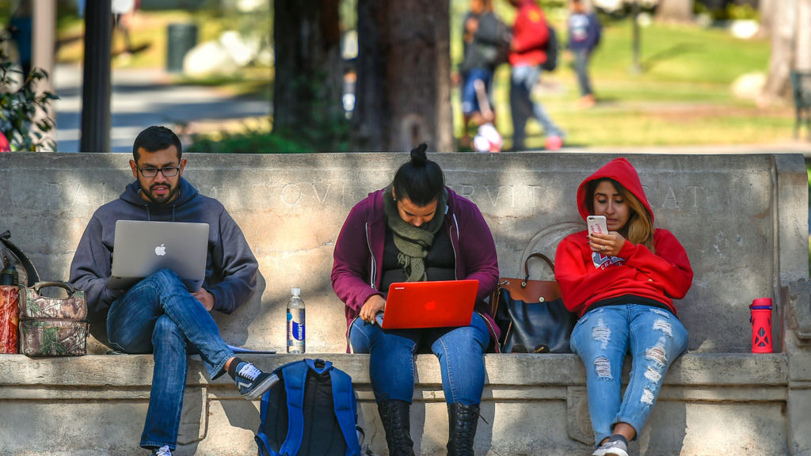

Accessibility means Inclusion
August 2022

Slide 2
Presentation
Agenda
01
ADA Basics (Why it Matters)
02
Building in Accessibility Common Issues
03
Applying Accessibility
Making your Events Inclusive
04
Where To Start
05
Materials & Resources

Slide 3

ADA Review
A comprehensive civil rights law.
An “Equal Opportunity” law that prohibits discrimination.
Guarantees that individuals w/disabilities have same rights as everyone else to participate in mainstream American life.
Equal enjoyment of employment, access to goods/services, participation in state and local government programs.
This Photo by Unknown Author is licensed under CC BY-SA-NC

Slide 4
Disability defined
Person with a physical or mental impairment that substantially limits one or more major life activities.
Person with a record of impairment even if they do not currently have a disability
Person without a disability but is regarded as having a disability
USC Students
USC Employees
USA
Est. 10%
Est. 5%
1:4
Notes:
Estimated 21% of Americans age 15 and older and over 50% of Americans over 65 years.
Estimated that 70% of all americans will have a permanent or temporary disability at some point in their life.
Major life activities include things like caring for oneself or others, performing manual tasks, walking, seeing, hearing, speaking, learning and working. Think anything that you do from the moment you get up to the moment you go to bed….can you do those daily tasks.
Think record of impairment – cancer
Regarded as – think you learn of someone being hospitalized for a medical or mental health condition

Slide 5
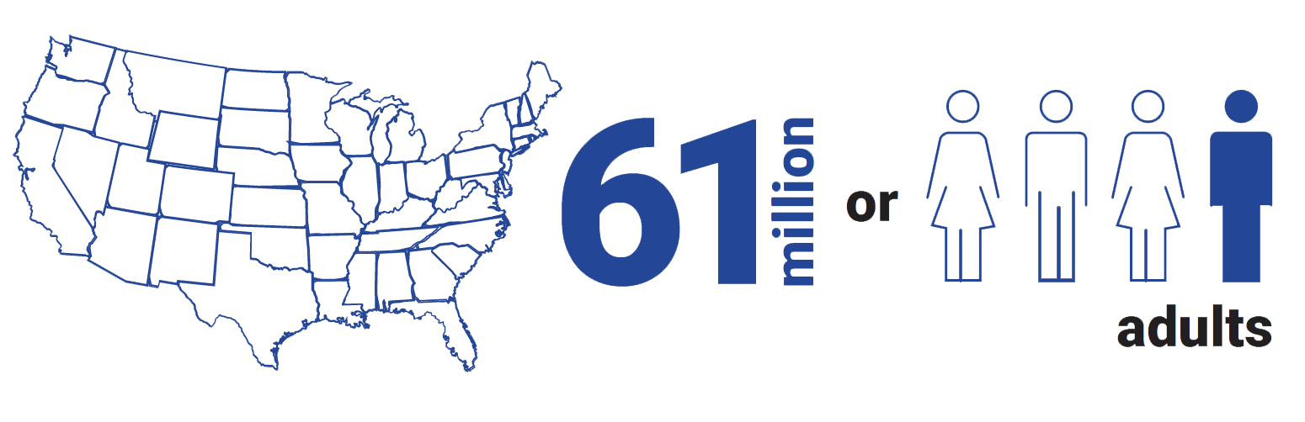
DISABILITY IMPACTS ALL OF US
Notes:
Matthew
These statistics are significant— this means accessibility needs to be an integral component of course design.

Slide 6






Including your diverse audience
Accessibility Benefits Everyone!
Visible disability
Non-traditional
learners
International audience
Temporary
disability
Mobile/ poor connection
Invisible disability
Notes:
Estimated 21% of Americans age 15 and older and over 50% of Americans over 65 years.
Estimated that 70% of all americans will have a permanent or temporary disability at some point in their life.
Major life activities include things like caring for oneself or others, performing manual tasks, walking, seeing, hearing, speaking, learning and working. Think anything that you do from the moment you get up to the moment you go to bed….can you do those daily tasks.
Think record of impairment – cancer
Regarded as – think you learn of someone being hospitalized for a medical or mental health condition

Slide 7
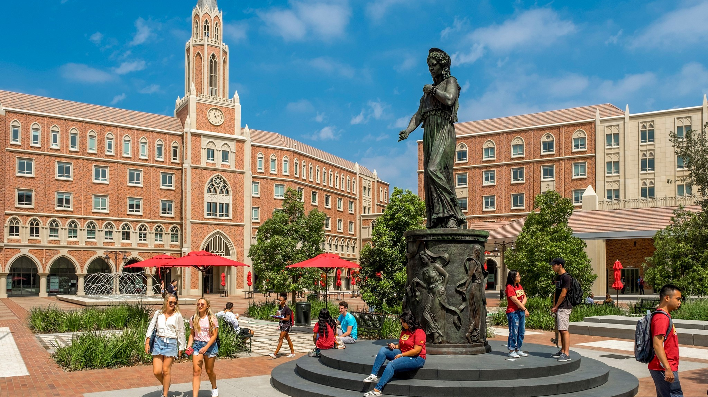
Building in Accessibility
Building in accessibility

Slide 8
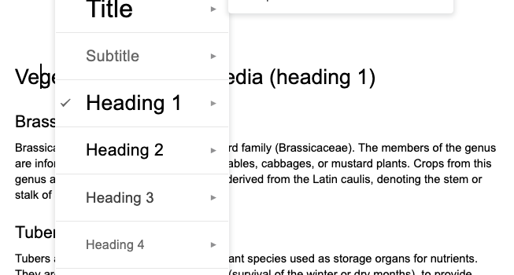
MOST COMMON ACCESSIBILITY ISSUES: HEADING STRUCTURE

Slide 9
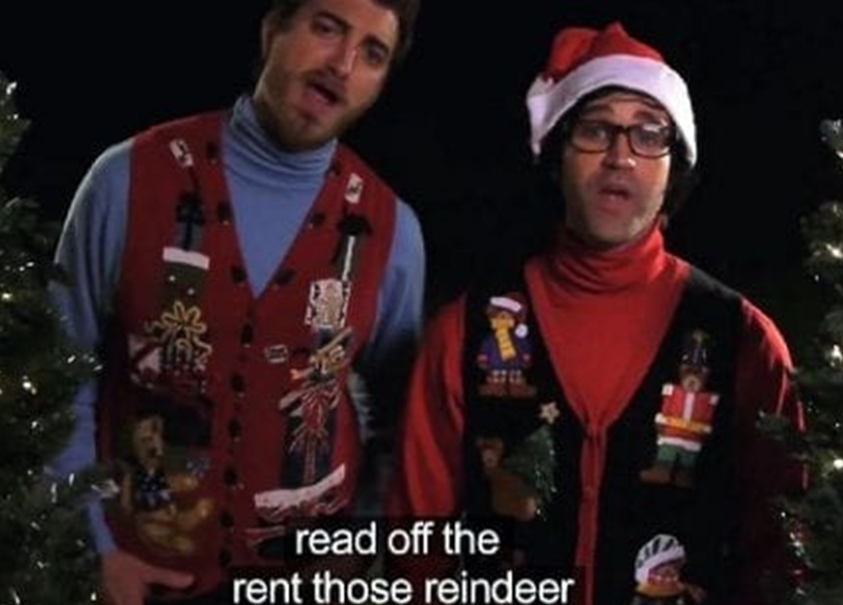
MOST COMMON ACCESSIBILITY ISSUES: CAPTIONED VIDEO
Notes:
Minh
- Make it simple but meaningful and informative . The text should be aligned with the context. (imagine you give a description for people on the phone)
- Alternative text can be used for image, shapes, clip arts, table, graph, video, audio

Slide 10
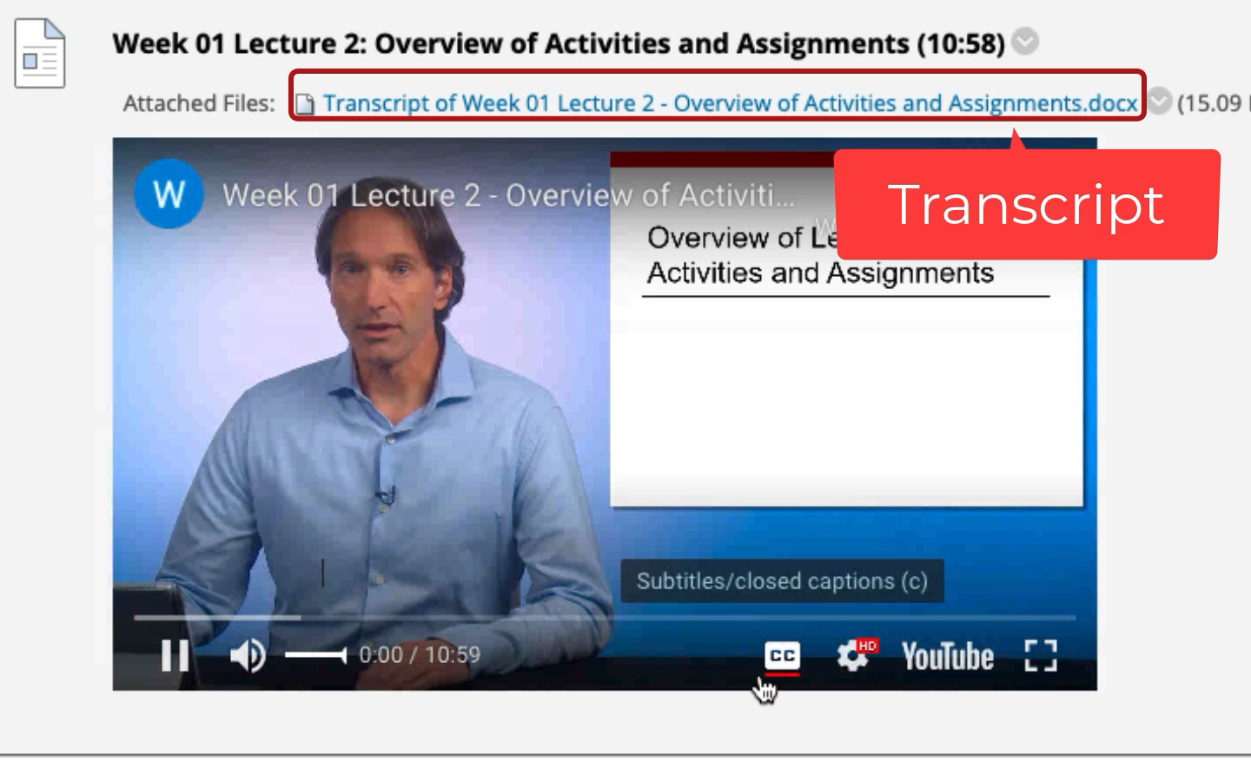
Captioned video
Video Closed Captions vs. Transcriptions
Closed captions
Narration appears on screen and follows the same timing
Transcriptions:
Narration presented in separate document
Notes:
Minh
Benefits for users who English is not their mother language, hearing loss, cognitive disease

Slide 11
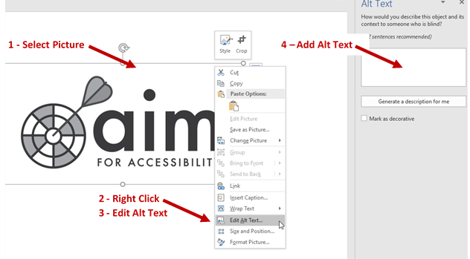
MOST COMMON ACCESSIBILITY ISSUES: ALTERNATIVE TEXT
Notes:
Minh
- Make it simple but meaningful and informative . The text should be aligned with the context. (imagine you give a description for people on the phone)
- Alternative text can be used for image, shapes, clip arts, table, graph, video, audio

Slide 12

MOST COMMON ACCESSIBILITY ISSUES: HYPERLINKS
https://support.microsoft.com/en-us/office/make-your-word-documents-accessible-to-people-with-disabilities-d9bf3683-87ac-47ea-b91a-78dcacb3c66d
To read the article, click here.
Read make your Word documents accessible to people with disabilities.
WRONG
WRONG
Notes:
Minh
User can quickly scan through all of the links on a web page using screen reader
- Meaningful and informative description

Slide 13
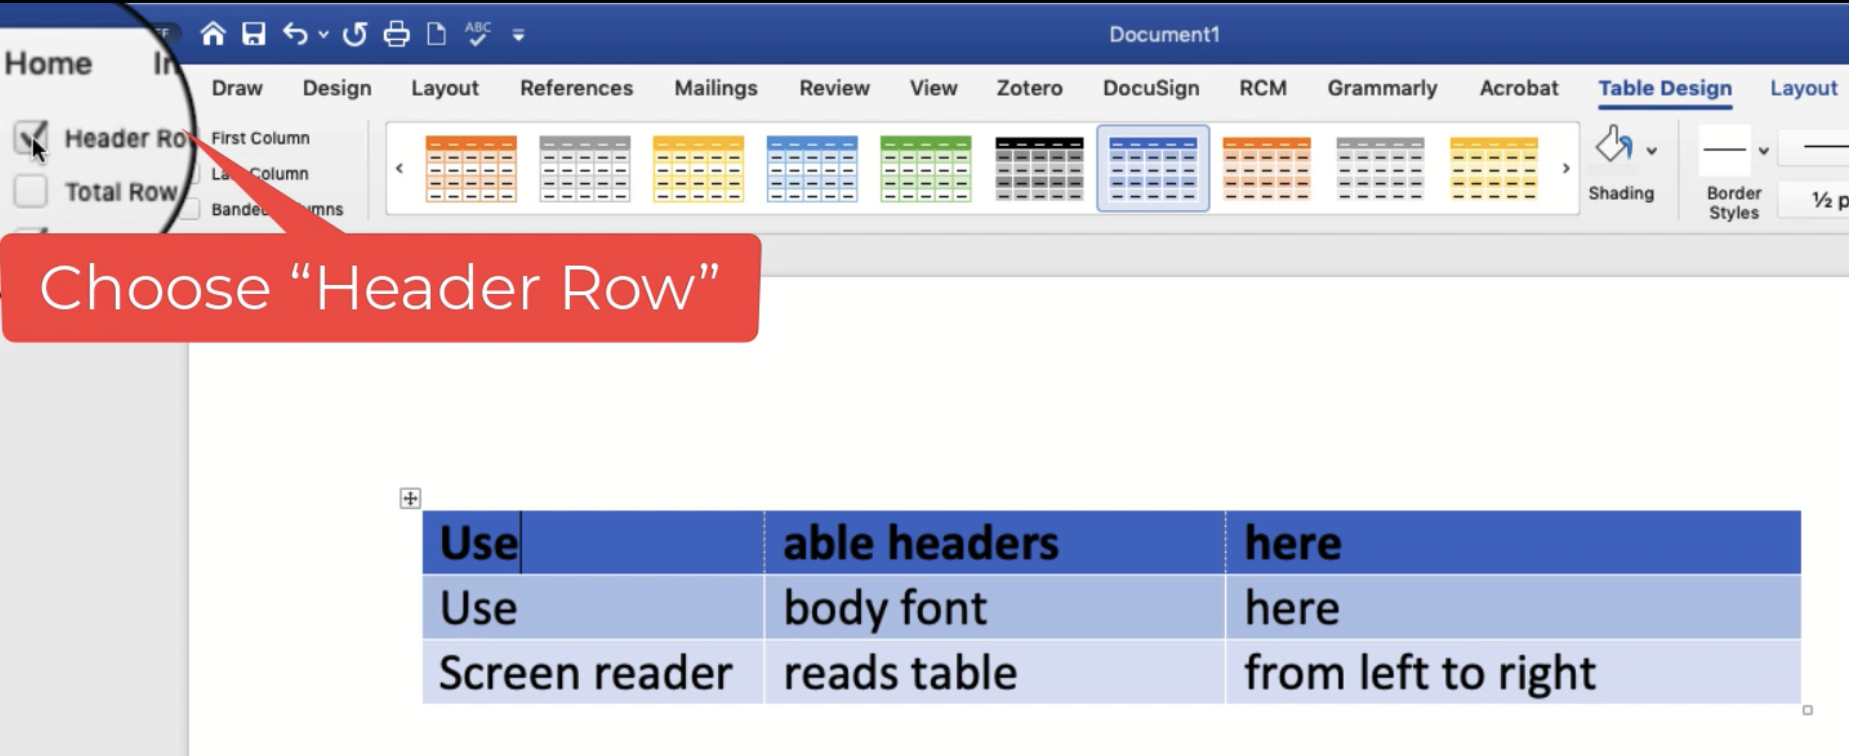
MOST COMMON ACCESSIBILITY ISSUES: TABLE HEADERS
Notes:
Minh
- Use the table to convey data, not for decoration
- Should use template

Slide 14
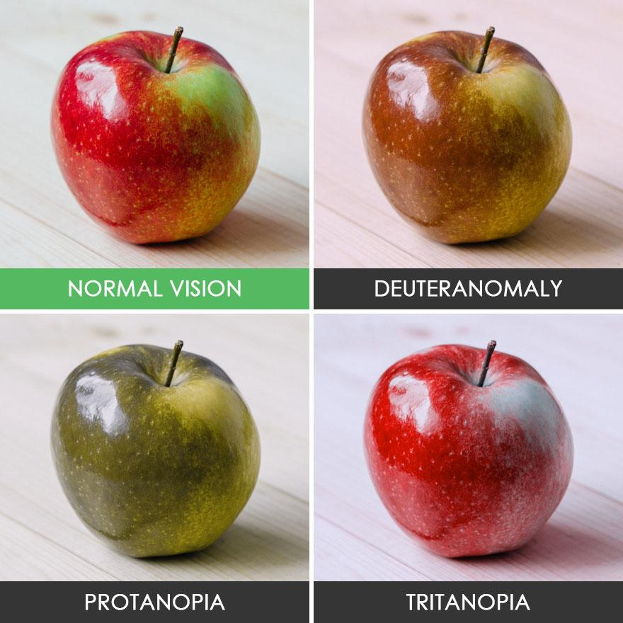
MOST COMMON ACCESSIBILITY ISSUES:
COLOR AND COLOR CONTRAST
Can you read me?
Can you read me?
Bad color contrast
Good color contrast
Notes:
Matthew
We should not rely on color to mark important items or differentiate items from one another.
Colors can enhance but should not be the sole identifier of distinction or importance.

Slide 15
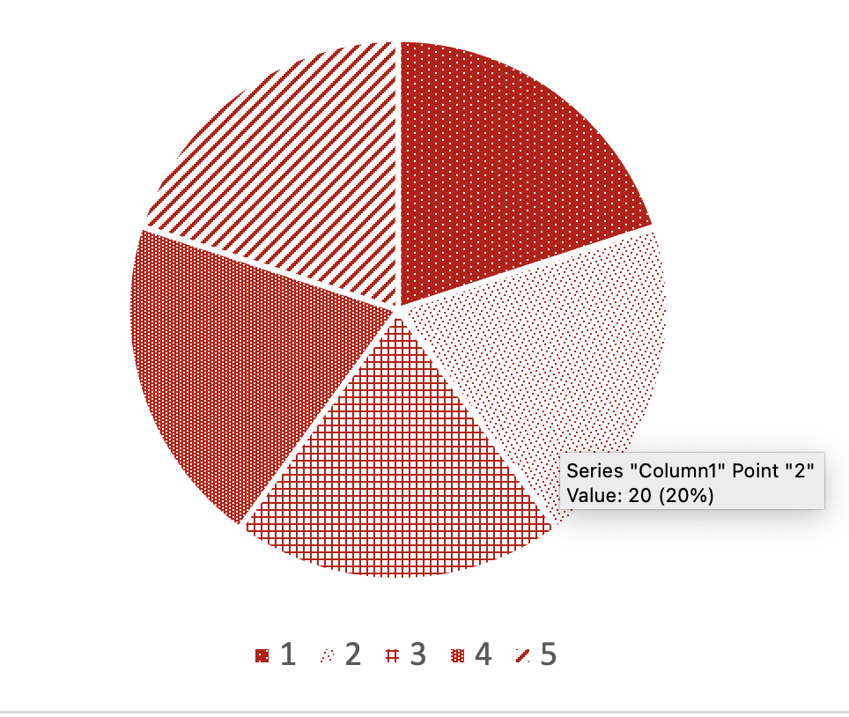
COLOR AND CONTRAST IN CHARTS
Car
50%
Bus
40%
Bike
10%
Color Contrast Check Tool
Notes:
Matthew
When we do need to use color to differentiate, there are other little tricks we can use to be even more accessible.

Slide 16

MOST COMMON USABILITY ISSUES: FONTS
Serif
Paper, Book
Times New Roman, Cambria
Sans Serif
Screens
Arial, Calibri, Verdana, Lato
Notes:
Minh
Serifs are naturally easier for the eye to read quickly and are therefore found in most books and newspapers. Sans-serifs on the other hand, mainly dominate the digital world on websites and apps.
Sans serif fonts improve readability for individuals with low vision and/or other types of print disabilities (e.g., dyslexia) and are easier to read in distance classroom

Slide 17
MOST COMMON USABILITY ISSUE: WHITE SPACE
Attached are instructions on how to use RGL 101 and the 2nd-floor classrooms. They are also available on the Price teaching site. However, as previously mentioned, not all of the features are ready yet as we are still undergoing testing and configuration.
Once the rooms are complete, we will be holding in-person training and will create step-by-step video tutorials. I look forward to showing you some of the more innovative features when they become available.
However, one important note is that until we complete testing, laptop connections for personal computers in RGL are not yet working – only the in-room PC. Therefore, you may want to bring your files on a USB key, save them to the M drive, or an online storage platform (e.g., Google Drive, Box, Dropbox, etc.).
Please review the attached documents before your class, and Anthony’s team from IT will be available for support.
Information Technology Services (ITS) is still investigating issues with the USC Secure and Guest Wireless Networks that may have impacted your ability to connect to the networks as well as faculty to run the network in the new general-use classrooms.
Notes:
Matthew
Cramming more information on one slide is the antithesis of accessibility.
But not just accessibility. Slides like this affect all learners.

Slide 18
INCREASING WHITE SPACE
LEADS TO 20% MORE COMPREHENSION! ​
“…properly using white space between paragraphs and in the left and right margins has been proven to increase comprehension up to 20% […]
The skill of using white space lies in providing your users with a digestible amount of content, then stripping away extraneous details.” (Cao et al, 2015)
Learn More: Why White Space is Crucial to UX Design
Notes:
Matthew
What does this mean? Good design is intentional and takes everything into consideration— color, font, size, and the amount of white space.
Notice how we are using a simple, white background for this presentation.
This also helps convert presentations to PDFs, which can easily be printed for further accessibility purposes.

Slide 19
ACCESSIBILITY VS USABILITY
Accessibility
Documents are formatted with titles and headings
Closed captioning and / or scripts provided for embedded media
Images are described and can be read by assistive technology
Usability
Videos embedded or directed links to videos
Longer text is broken up into smaller pieces
Materials are organized in folders
Notes:
Matthew
After this, punt over to Jonathan so he can talk about accommodations in general

Slide 20
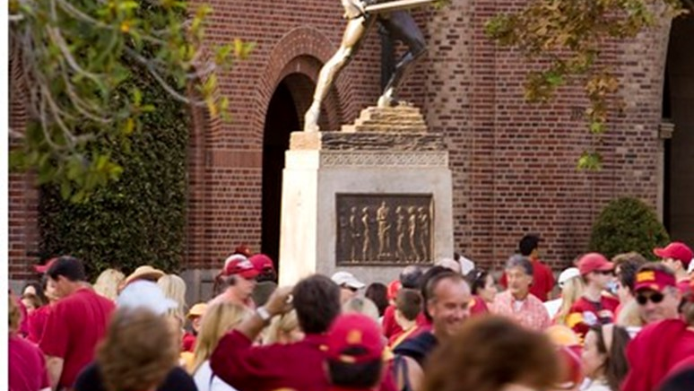
Marketing and Social Media
MAKING YOUR Events iNCLUSIVE
Applying Accessibility

Slide 21


Considerations
Who
What & Where
How
Do you know your audience?
How large is the audience?
Type of event
How far out planning wise
How far out marketing wise
Site selection
Vendor selection
Requests for accommodations
Consultations

Slide 22
Marketing
Includes:
Promotions
Selling of product/services
Market research
Advertising
Invitations & RSVPs
Includes 3rd party vendors
Social Media
Print & Online

Slide 23
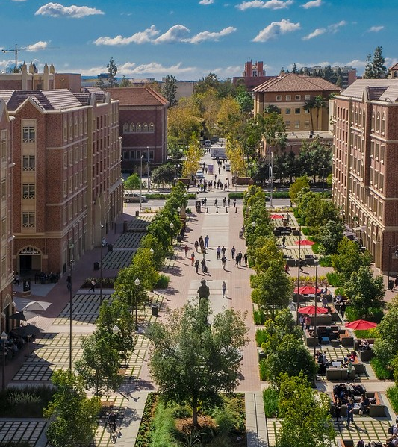
Marketing requirements
Ask
Could someone with visual, hearing, or mobility impairments access my content?
If not, how can you format your content to make it accessible?
Our Office in New Jersey
Notes:
Need accommodations? visit <insert website> to learn more or contact <insert name and contact information).

Slide 24
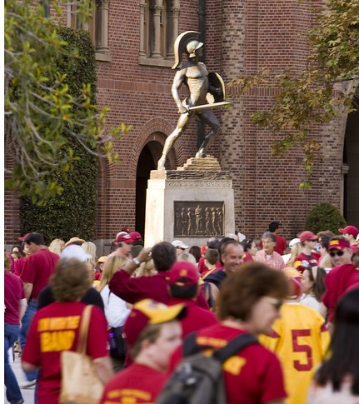


Invitations & rsvp’s
Designated Point Person
Identify an individual & provide name, number, email and website.
Accessibility statement
Long description statement if space
Short description pointing to website if little space
RSVP
Consider a question: Are accommodations needed to attend this event? (check box or text box)
Designated point person contact information.

Slide 25
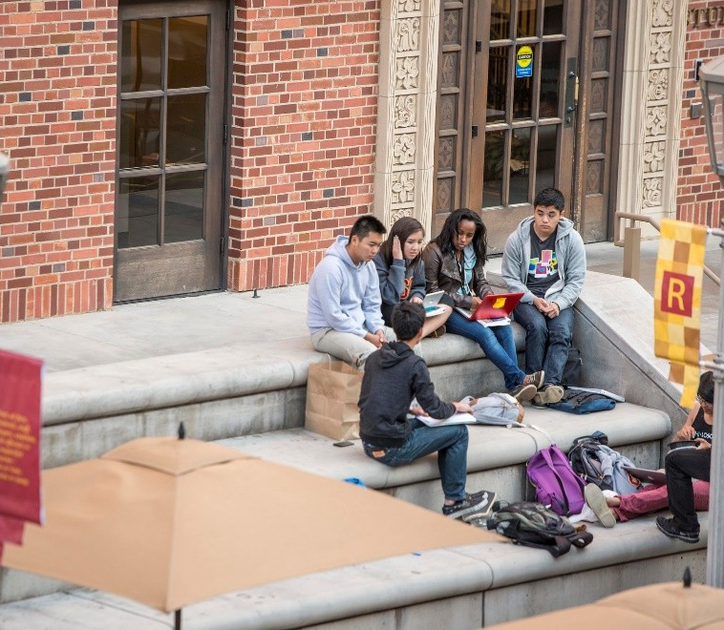


Social Media Considerations
Accessibility is only as good as your last post.
Captions
Content created or curated must be captioned prior to posting
Images
Provide descriptive alternative text to images or mark as decorative
content
Text is best (consider your use of graphs, charts, statistics, and PDFs)

Slide 26
TAKEWAY
Accessibility helps all types of learners in all types of situations
Planning for accessibility takes thought and time — it cannot happen overnight
This presentation will be available on the Price accessibility page
Notes:
Matthew

Slide 27
Where to start: usc and price
USC OFFICE OF STUDENT ACCESSIBILITY SERVICES
Osas.usc.edu
PRICE Office of online education and digital media
priceoedm@usc.edu

Slide 28
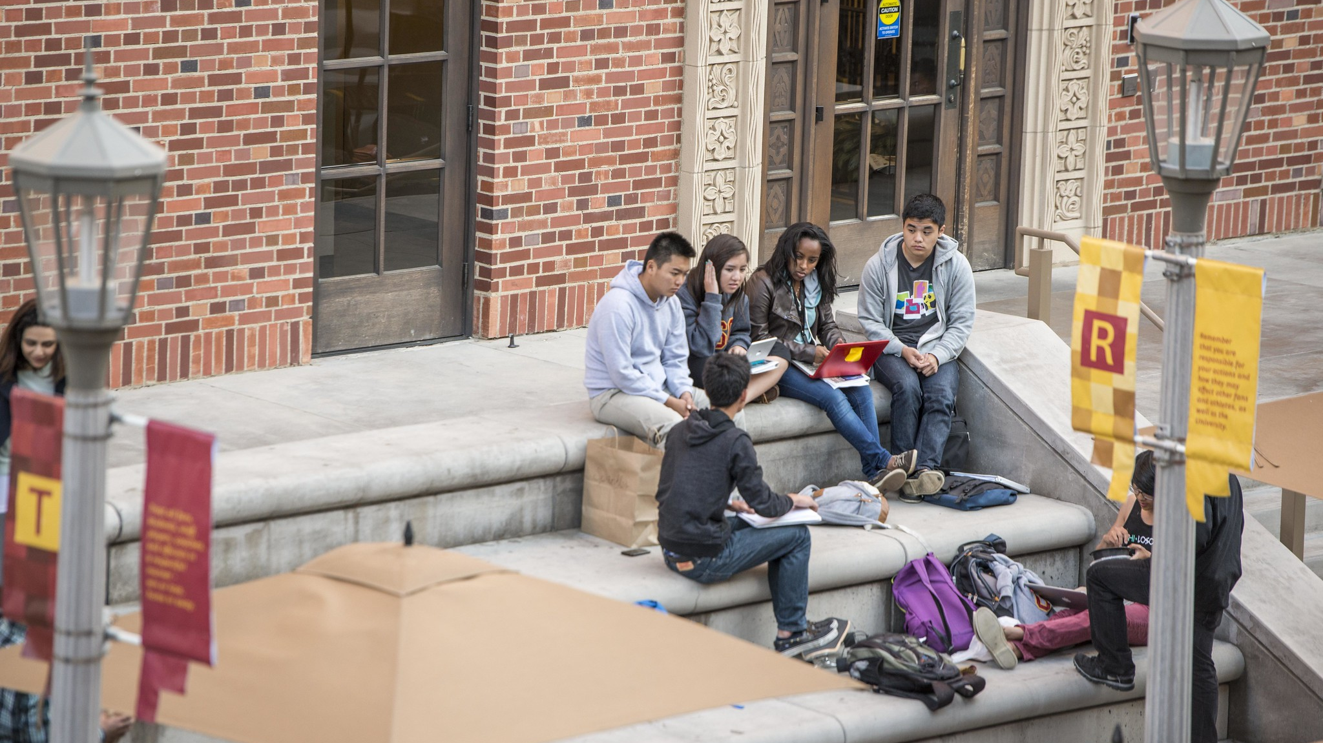
Resources
resources

Slide 29


General Resources
Website
Documents
Maps
Institutional Accessibility & ADA Compliance
USC Guide to Creating Accessible Content.
Microsoft Guides: Word / PowerPoint
Check out USC’s new Interactive Map
Social media
Accommodation Requests
One stop Shop resource list
Check out our tips on Social Media Content
Check out: Accommodation Requests
OIA’s Resource Compilation List

Slide 30
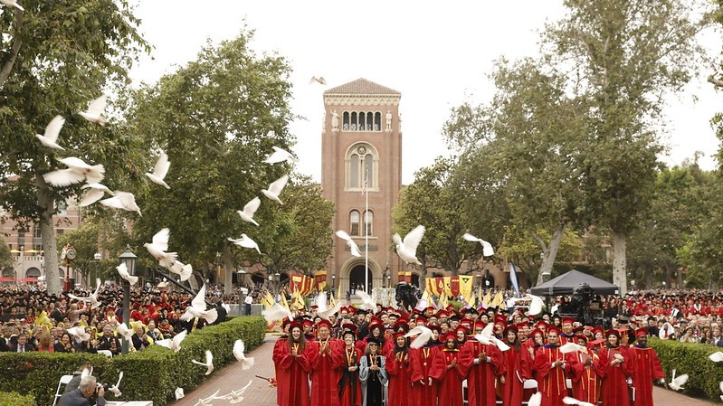
THANK YOU
& Fight On!

Slide 31





SOCIAL MEDIA @ Price
Events
Professional Updates
Price in the News
Research updates
Student Life @ Price
Networking
CONTESTS!

Slide 32
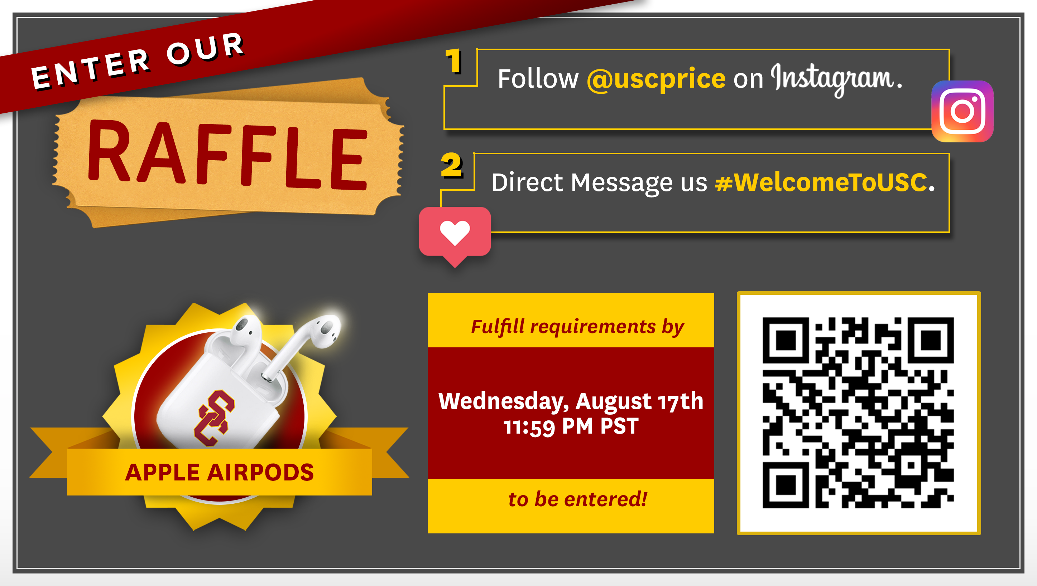
CONTEST AND QR

